Slide 1


RSA exercises
Day 4
Tonghe & Zuza

Slide 2
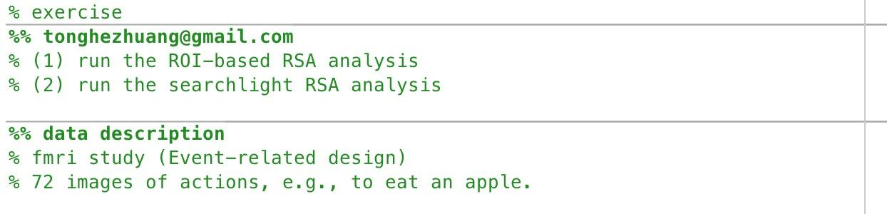

Slide 3
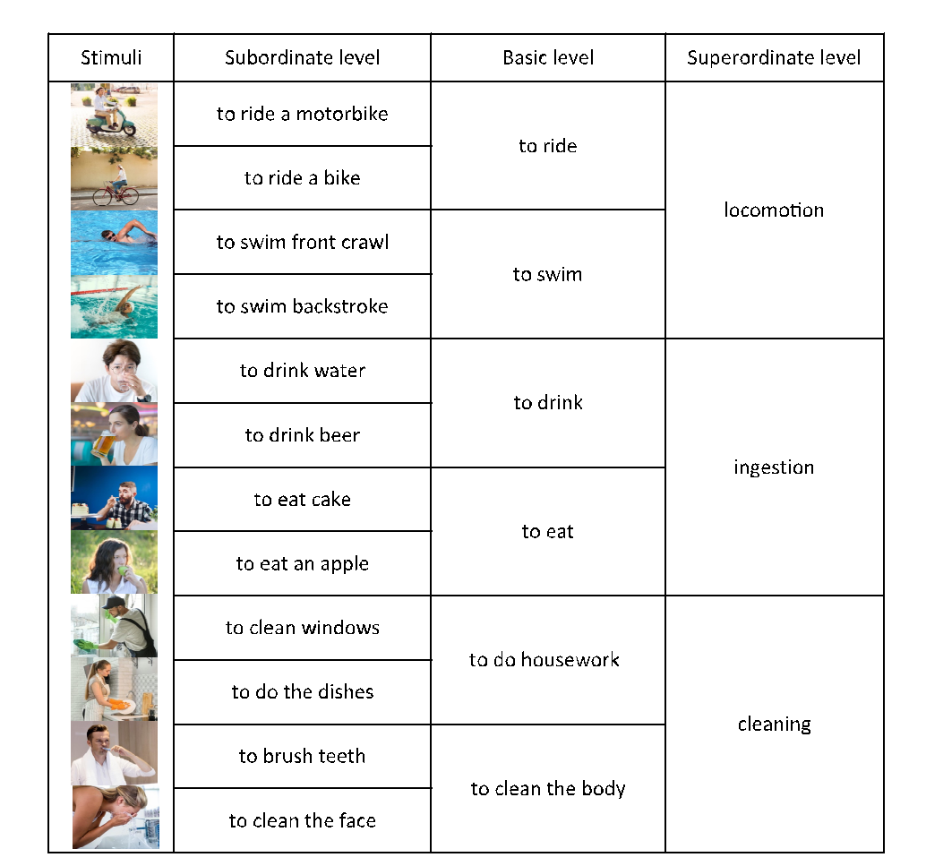
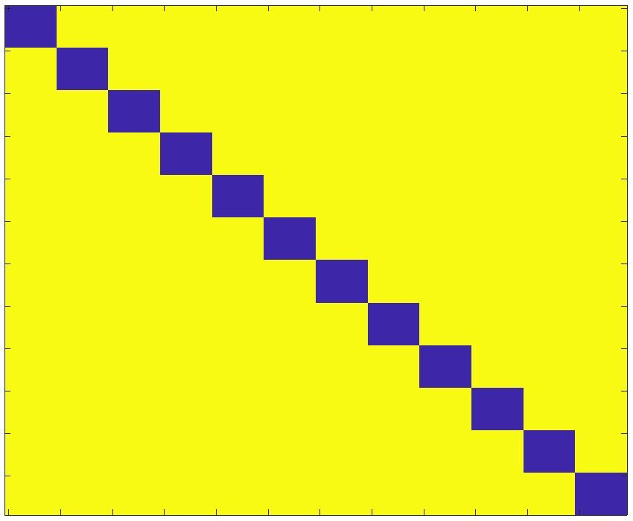
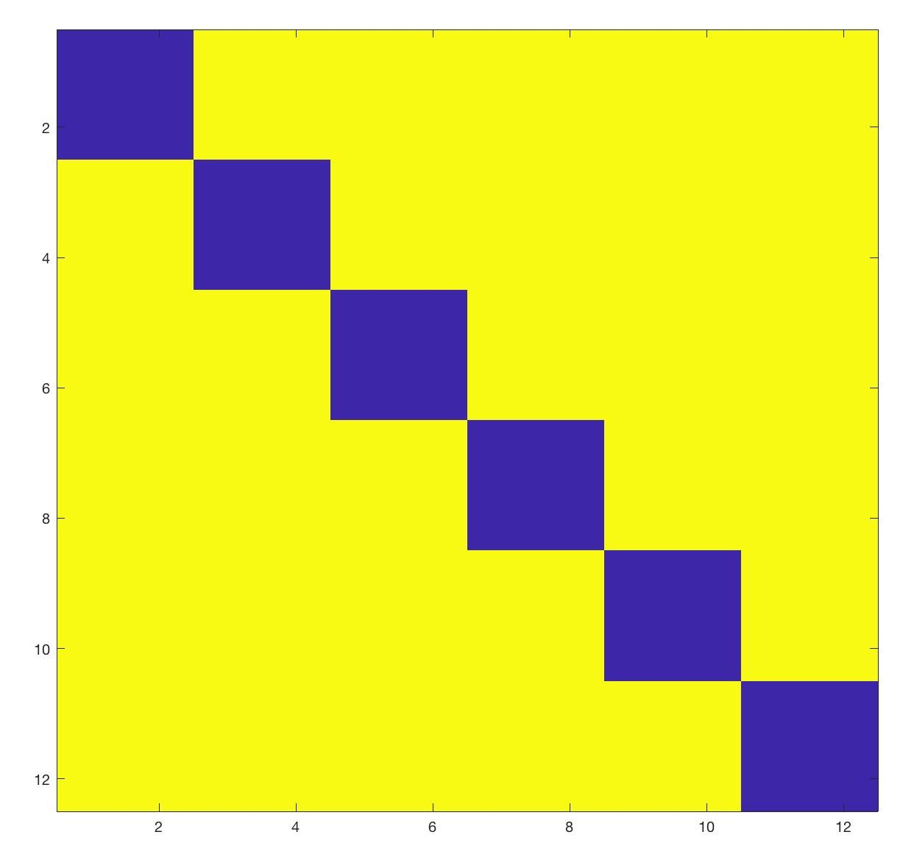
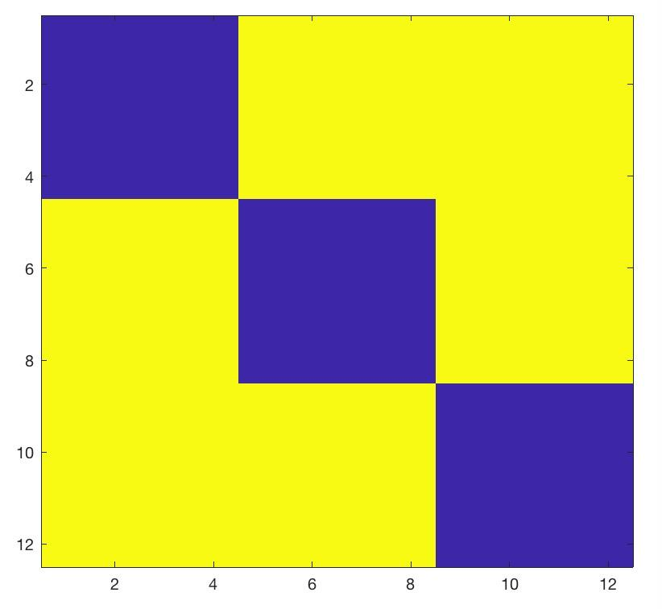
fMRI Experiment
--materials--
72 images * 6 runs
12 actions with 6 exemplars per action
Subordinate level
Basic level
Superordinate level

Slide 4
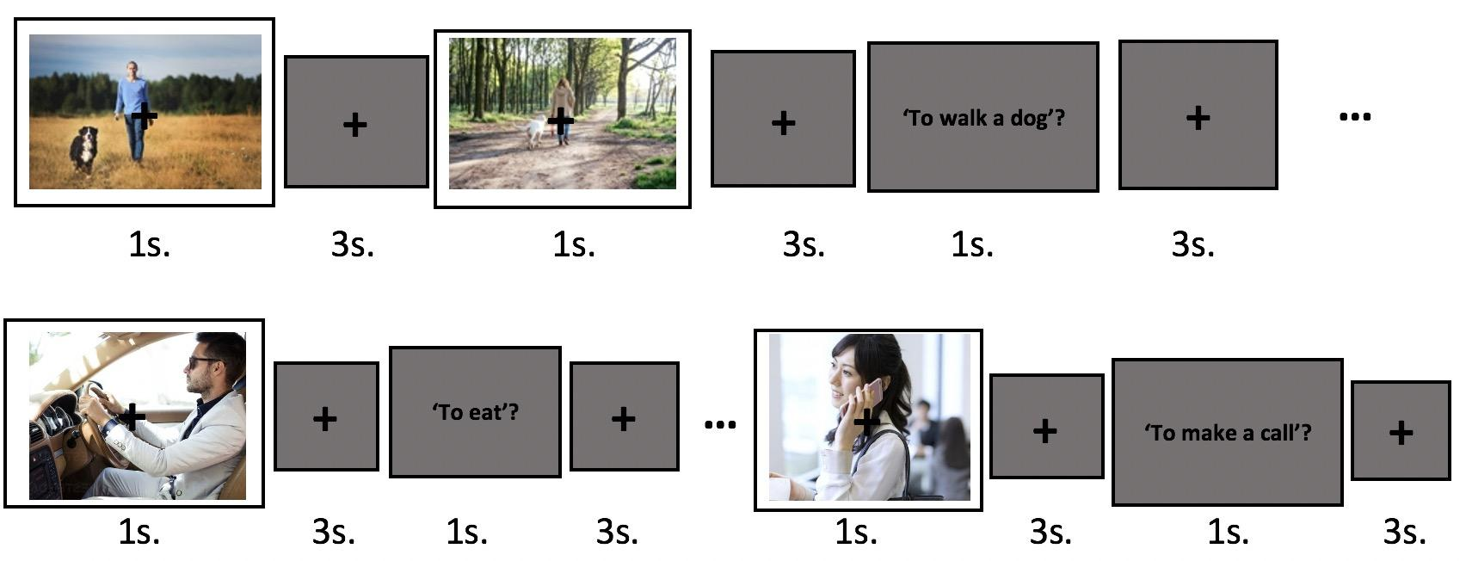
fMRI design

Slide 5
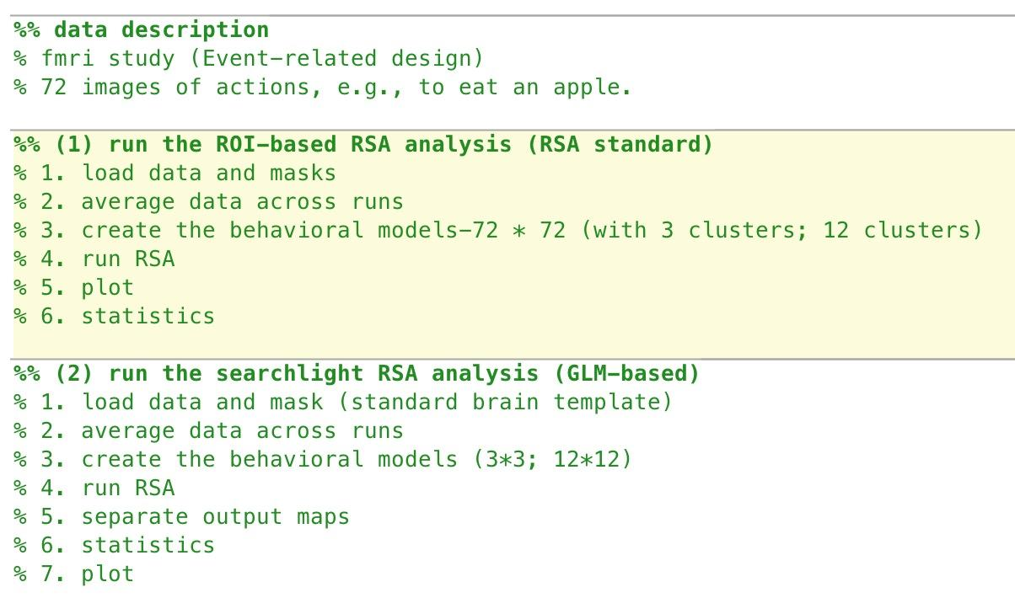
Superordiante level
Subordiante level
72 images * 6 runs
12 actions with 6 exemplars per action

